Slide 1
Recommendation System Using Collaborative Filtering
A deep dive into building personalized movie recommendations using the MovieLens dataset — from exploratory data analysis to SVD-based matrix factorization and cosine similarity.
MACHINE LEARNING · RECOMMENDER SYSTEMS

Slide 2
Problem Statement
Users face information overload — browsing hundreds of titles without finding content that matches their taste. The goal: build a personalized movie recommendation engine that surfaces the right content for each user.
Exploratory Analysis
Cosine Similarity
SVD Model
Understand rating patterns and data distributions
Measure user-to-user behavioral similarity
Factorize the user-item matrix for predictions
RMSE Evaluation
Top-5 Recs
Quantify model accuracy on held-out ratings
Generate ranked recommendations per user

Slide 3
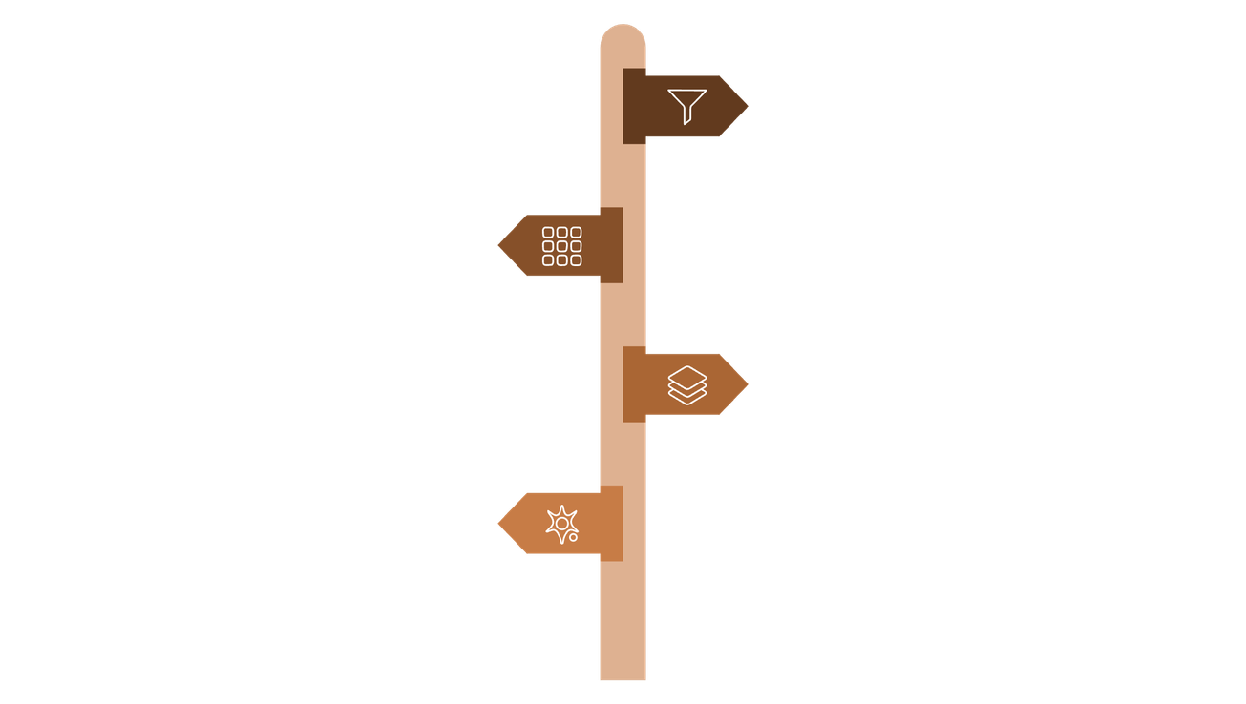

Dataset & Methodology
Pipeline Overview
MovieLens Dataset
A widely used benchmark in recommender systems research. Each record captures a User ID, Movie ID, and a numeric rating, forming the raw signal for all downstream modeling.
Data Preprocessing
Clean ratings, handle missing values, and normalize.
User-Item Matrix
Construct sparse matrix of users vs. movies.
Sparse user-item matrices are the norm — most users rate only a small fraction of available movies.
Similarity Calculation
Compute user or item similarities (cosine).
SVD Model
Factorize matrix and predict missing ratings.

Slide 4

Exploratory Data Analysis
The rating distribution reveals a classic long-tail pattern — a small number of popular movies accumulate the vast majority of ratings, while most titles receive very few. This sparsity is the central challenge collaborative filtering must overcome.
The long tail means most collaborative filtering signal is concentrated in a small subset of items — handling cold-start for rare movies is critical.

Slide 5

Cosine Similarity
Cosine similarity quantifies how alike two users are by measuring the angle between their rating vectors in item space. A score of 1 means identical preferences; 0 means no overlap.
Formula
Why It Works
Robust to users who rate on different absolute scales
Efficient to compute on sparse matrices
Interpretable similarity score between 0 and 1
Forms the backbone of user-based CF neighborhood selection
Implemented efficiently using NumPy dot products and L2 norms on the user-item matrix.

Slide 6

SVD Model & Evaluation
Model Performance
Singular Value Decomposition
RMSE = 0.352
SVD decomposes the user-item rating matrix into latent factor matrices, capturing hidden preferences and item attributes. Missing ratings are predicted by reconstructing the matrix from learned factors.
Achieved on held-out test ratings — significantly below the 1.0 threshold considered strong for 5-star scales.
Why SVD Wins
Outperforms memory-based CF by generalizing across the full user-item space rather than relying on exact neighbor matches.
Decompose Matrix
Learn Latent Factors
Predict Missing Ratings
Lower RMSE = higher prediction accuracy. 0.352 indicates the model's predicted ratings deviate by less than 0.4 stars on average.

Slide 7
Model Output: Top-5 Recommendations
The SVD model generates a ranked list of predicted ratings for unseen movies. Below is a sample output for User 1, alongside the RMSE confirmation.
Predicted ratings range from 3.99 to 4.97, reflecting high-confidence recommendations for a user whose latent profile aligns strongly with classic action and sci-fi titles.

Slide 8
Future Scope
Web Application
Deep Learning Models
Larger Datasets
Deploy the recommendation engine as an interactive web app, enabling real-time personalized suggestions with a user-friendly interface.
Integrate neural collaborative filtering (NCF) or transformer-based architectures to capture non-linear user-item interactions.
Scale to the full MovieLens 25M dataset or domain-specific corpora to improve coverage and reduce cold-start issues.

Slide 9
Conclusion
This project demonstrates a complete collaborative filtering pipeline — from raw MovieLens data to deployable Top-5 recommendations. SVD-based matrix factorization emerged as the strongest approach, achieving an RMSE of 0.352 and producing coherent, preference-aligned suggestions.
01
Data Processed
MovieLens cleaned and structured into a user-item matrix
02
The end-to-end system was built and validated successfully, confirming that model-based CF outperforms memory-based approaches on this benchmark.
Similarity Computed
Cosine similarity identified nearest-neighbor users
03
SVD Trained
Latent factors learned; missing ratings predicted
04
RMSE = 0.352
Model accuracy validated on held-out test set

Slide 10
Thank You

